Slide 1

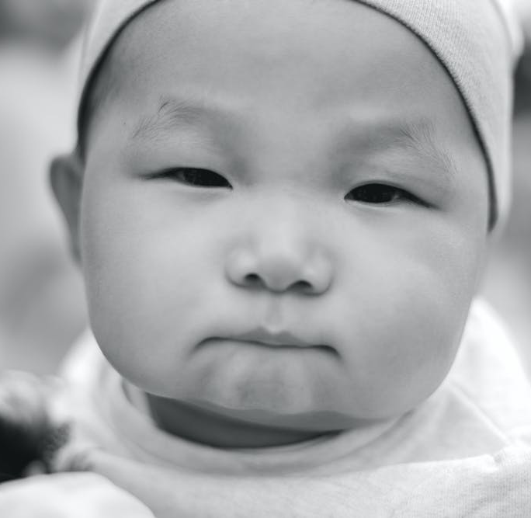





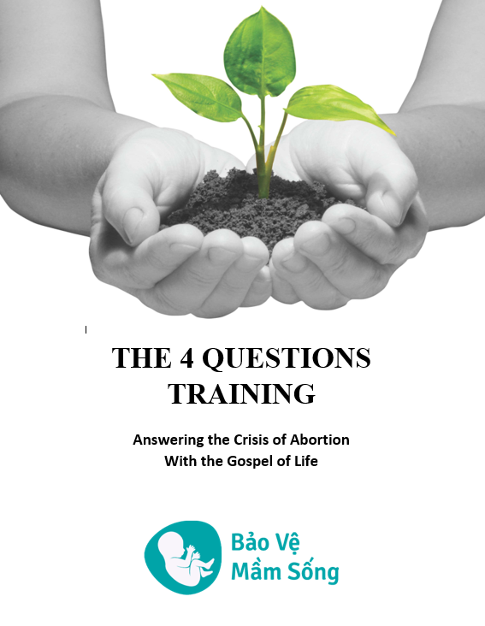


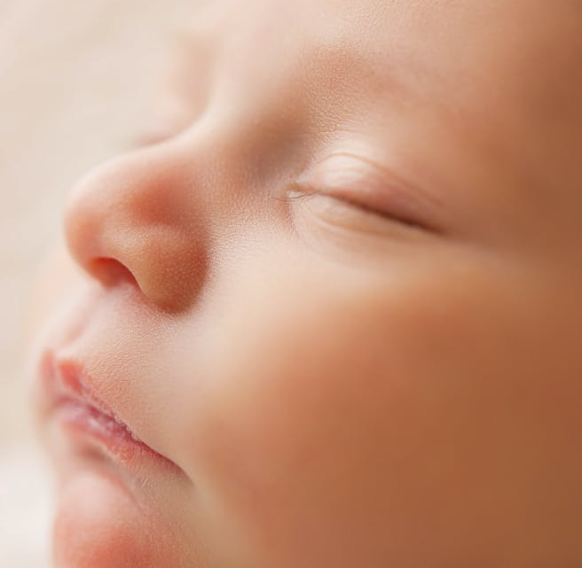
The 4 Questions Training
Answering the Crisis of Abortion
  with the Gospel of Life
  For English, Vietnamese, Hmong
  Download at:
  www.baovemamsong.org

Slide 2
The 4 Questions Training
Answering the Crisis of Abortion with the Gospel of Life
The Crisis:
  Abortion ends the life of a baby – this is THE BIG ISSUE!
  Abortion damages women - leaving a lifetime of grief, suffering and guilt.
    Women are abandoned or pressured during their pregnancy crisis.
    Women – who are created to nurture life – are led to take life!
  Abortion damages men.
    Men - created to protect, defend and nurture life (and family) - abandon their values as men when they fail to protect women and babies from abortion harm and death.
  Abortion damages relationships – unresolved guilt, resentment, anger…
  Abortion affects family members and society.
Abortion is the Leading Moral Crisis in our modern time!
    It was the leading cause of death worldwide in 2021 - killing 42.6 million babies!
Notes:
The 4 Questions Training.
Answering the Crisis of Abortion with the Gospel of Life.
The ‘Crisis?’
Abortion ends the life of a baby in the womb - before it can be born. This is the NUMBER ONE BIG ISSUE with abortion. If there were no other bad consequences of abortion, this is enough reason to say “abortion is wrong, don’t do it!” Why? Because a baby is killed!
But, abortion affects others also:
Abortion damages women - leaving a lifetime of grief, suffering and guilt.
Women are abandoned or pressured during their pregnancy crisis – when they need support the most!
Women – who are created to nurture life – are led, or left, to take life!
Abortion damages men.
Men – who are created to protect, defend and nurture life (and the family) - abandon their values as men when they fail to protect women and babies from abortion harm and death.
Abortion damages relationships – unresolved guilt, resentment, anger leads to distance and coldness in relationships…
Abortion affects family members – Siblings may feel anger or sadness at the loss of their brother or sister. Grand parents also may feel angry that their grandchild was aborted.
Abortion affects society - Society may experience gender imbalance, for example, not enough women for men to marry. This has happened in provinces in China because of abortion.
Abortion is the Leading Moral Crisis in our modern time!
42.6 million deaths - It was the leading cause of death worldwide in 2021 - killing 42.6 million babies!
Abortions far outnumbered every other cause of death. By contrast:
8.7 million people died of cancer in 2020.
5 million died from smoking.
13 million died from disease.
1.7 million died of HIV/AIDS
Covid deaths in 2020 were approximately 3.5 million – that means abortion is 12 times more deadly than coronavirus!
The ‘Gospel of Life’ is our way of summarizing what God says regarding human value and all that God commands us to do to cherish and protect human life.
The ‘Gospel of Life’ moves men and women to act with compassion:
To reject abortion,
To offer help to women in pregnancy crisis,
To speak to men of their responsibility in abortion,
To bring God’s healing grace to grief and suffering in post-abortion women.

Slide 3
The 4 Questions Training
Answering the Crisis of Abortion with the Gospel of Life
Abortion is a moral issue!
It is a symptom of a deeper ‘heart problem.’
Therefore, to stop abortion, what’s needed is a change of the heart and mind in both men and women!
      To appreciate the value of all human life - valued above all else!
      To have a readiness for responsibility - willing and able to act and rescue the innocent from death!
The gospel of life brings that change.
The ‘Gospel of Life’ is our way of summarizing;
      what God says regarding human value and,
      all that God commands us to do to cherish and protect human life.
Notes:
The 4 Questions Training.
Answering the Crisis of Abortion with the Gospel of Life.
Abortion is a moral issue! It is a symptom of a deeper ‘heart problem.’
(Although it is usually performed by doctors), in reality, abortion is not a medical issue, but a moral issue.
Therefore, what’s needed is a change of the heart and mind in both men and women!
To appreciate the value of all (even the unborn) human life – valued above all else!
To be willing to act and rescue the innocent from death!
The gospel of life brings that change.
The ‘Gospel of Life’ is our way of summarizing;
what God says regarding human value and,
all that God commands us to do to cherish and protect human life.

Slide 4
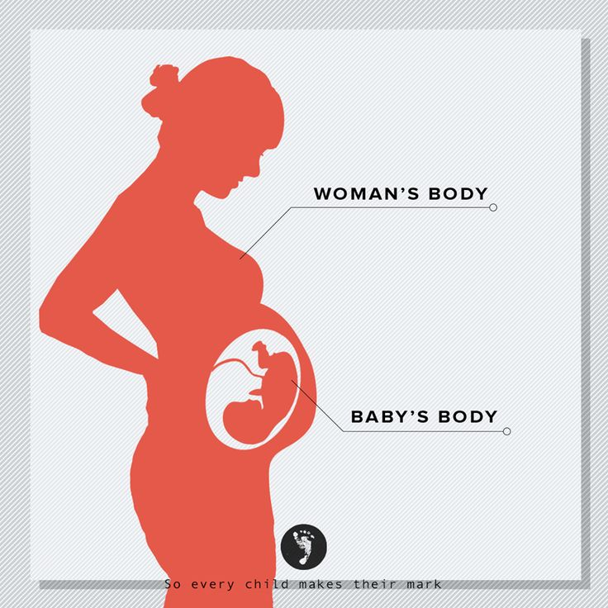
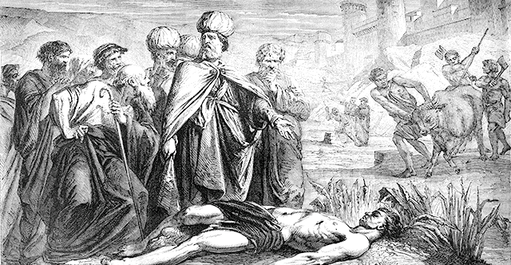
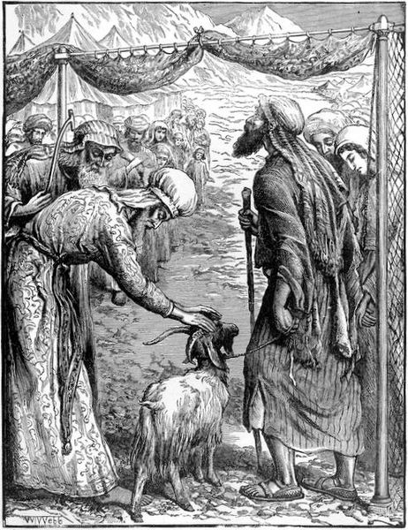
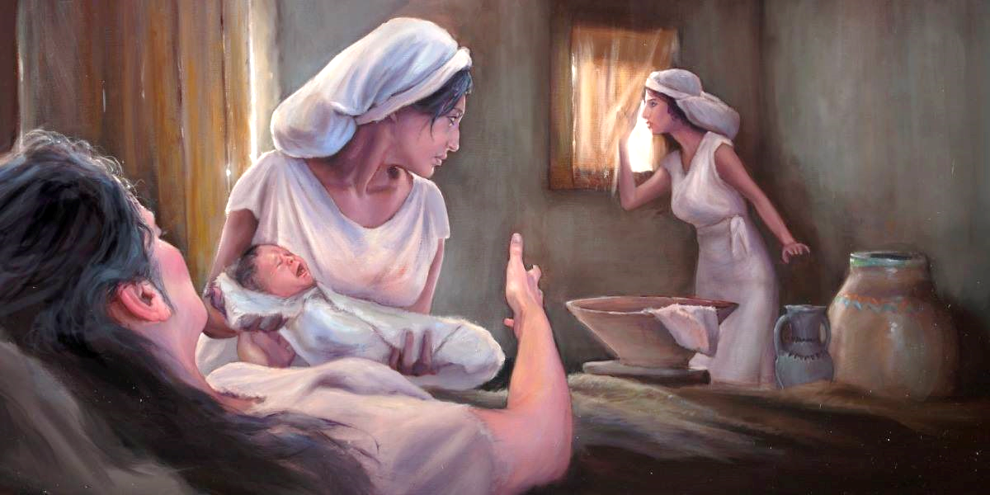
The 4 Questions Training
Answering the Crisis of Abortion with the Gospel of Life
We will explore these ‘Gospel of Life’ themes through 4 Questions:
Question 1: What does God say about Human Life, Including Life in the Womb?
Question 2: What does God say about the Shedding of Innocent Blood, including Abortion?
Question 3: How does the Gospel Take Away the Guilt of Abortion?
Question 4: What does God Call us to do to Stop the Shedding of Innocent Blood?
Notes:
This is an overview of the Four Questions Training.
These are the 4 questions we will answer.

Slide 5
The 4 Questions Training
Answering the Crisis of Abortion with the Gospel of Life
Question 1
Part 1: What does God say about Human Life?
Part 2: Including Life in the Womb?

Slide 6
Question 1 - Part 1: What does God say about human life?
A Christian view of human value is based on mankind being created
by God in the image of God.
Gen. 1:26-28
Then God said, “Let us make mankind in our image, in our likeness…
…so that they may rule over… all the creatures…” [of the earth]
So God created mankind in His own image; in the image of God He created them,…
God blessed them and said to them, “Be fruitful and increase in number; fill the earth and subdue it. Rule over…every creature…”
Every human life is endowed with a profound dignity, value and destiny.
Mankind is God’s ‘special’ creation:
  Unlike the rest of creation, human beings are made in God’s own image – according to his likeness.
  God crafted man by his hands, then breathed his life into man (2:7).
  Man shares in God’s image and likeness – He is a reflection of God’s image and glory.
  Mankind is given dominion over God’s creation (1:28).
Every person born through the natural process of procreation are also individuals carefully crafted by God. (Psa. 139:13-14)
Therefore

Slide 7
Chapter 1 What does God say about human life, including life in the womb?
Question 1 - Part 1: What does God say about human life?
So we affirm that every human being is created with these four values:
Intrinsic value – Our humanity alone, rather than our capacities or abilities, is what gives us value to God.
Equal value – All people; male and female, from every ethnicity, from every generation, and every socio-economic level are equal.
Exceptional value – People are more valuable than everything else in creation!
Eternal value – People live eternally – they have an eternal destiny.
What does God value most in the world?
  He values human life – people.
  Both individually and together.
Psa. 8:5-6 You have made them a little lower than the angels and crowned them with glory and honor. You made them rulers over the works of your hands; you put everything under their feet.
Psa. 116:15 Precious in the sight of the Lord is the death of his faithful servants.
Isa. 49: 15-16 “…I will not forget you! See, I have engraved you on the palms of my hands.”
Mat. 10:30-31 “…even the very hairs of your head are all numbered. So don’t be afraid you are worth more than many sparrows.”
Notes:
So we affirm that every human being is created with these four values:
Intrinsic value: Our humanity alone, rather than our capacities or abilities, makes us valuable to God.
Is a math genius more valuable to God than an average student? No!
If I have no arms and legs, am I less valuable to God? No!
What about a person who has Down Syndrome? Is he/she less valuable to God? No!
What if a person is unconscious?
Equal value: All people, male and female, from every ethnicity, throughout the ages are equal.
Are boys more valuable than girls? No!
If I own a car, am I more valuable than a poor man who walks? No!
Is an American more valuable than a Japanese? No!
Exceptional value: Human beings are more valuable than anything else in creation.
More valuable than money? Yes!
More valuable than animals? Yes!
More valuable than my career or position in the company? Yes!
More valuable than my reputation? Yes!
Eternal value: As image bearers of the eternal God, we also possess a special dignity and eternal destiny.
How long will a person live? 80 years or eternity? Eternity! Mat. 25:46
Here’s a great question, ‘What does God value most in the world?’
As we are seeing, He values human life – people.
These bible verses help us see this.

Slide 8
Chapter 1 What does God say about human life, including life in the womb?
Question 1 – Part 1: What does God say about human life?
How does the Bible define Life?
God is life and God gives life:
  Job (12:10) said:
  “In his hand is the life of every living
  thing, and the breath of all mankind.”
God cherishes life (He seeks to preserve, save and rescue lives from death).
  To Solomon he is the rescuer of life (Psa. 72:12-14):
  “He will… save the needy from death. He will rescue them from oppression and violence, for precious is their blood in his sight.”
  To Joseph he is the preserver of life. Joseph said to his brothers Gen. 45:5:
  “…for God sent me before you to preserve life.”
God’s gift of Christ is the gift of life.
  Jesus gives life abundantly in
  John 10:10.
  Jesus gives life everlasting in
  John 3:16.
The gospel of Christ is a gospel of life
  “…we are to God the pleasing aroma of Christ… the aroma that brings life”
  2Cor. 2:15-16
Notes:
How does the Bible define (human) Life?
God is life and God gives mankind life:
Gen. 2:7: God is the breath of life (to Adam).
Deut. 30:20: Moses said: “…for He is your life and the length of your days;…”
Job 12:10: Job said: “In his hand is the life of every living thing, and the breath of all mankind.
Pro. 8:35: Whoever finds me finds life.
God cherishes life:
Psa. 54:4: To David He is the upholder of life. David said; “…God is my helper. The Lord is with those who uphold [sustain] my life.”
Gen. 45:5 To Joseph He is the preserver of life. Joseph said to his brothers; “…for God sent me before you to preserve life.”
Psa. 41:2: David said “The Lord will preserve… and keep… alive.”
Psa. 72:12-14: To Solomon he is the rescuer of life. “He will… save the needy from death. He will rescue them from oppression and violence, for precious is their blood in his sight.”
Psa. 121:7: He watches over your life.
Pro. 14:27: He is the fountain of life (to those who fear him).
God’s gift of Christ is the gift of life.
John 8:12 Jesus is called the light of life.
John 10:10 Jesus gives life, and life abundantly.
John 3:16 Jesus is everlasting life.
The gospel of Christ is a gospel of life
2Cor. 2:15-16: “…we are to God the pleasing aroma of Christ… the aroma that brings life.

Slide 9
Chapter 1 What does God say about human life, including life in the womb?
Question 1 – Part 1: What does God say about human life?
What are Some Social Implications of Human Life Created in God’s Image?
All people and all ethnicities are truly equal!
  One common ancestor (Adam).
  God has no favorites and sees no difference!
  (Races, gender, class – No inferiority nor superiority)!
How we treat others is, ‘actually,’ how we treat God!
  Hate towards people is to hate God – their creator!
  Being kind to the needy or helping the weak honors God.
Acts 17: 26
From one man he made all the nations,…
Acts 10:34
Then Peter began to speak: “I now realize how true it is that God does not show favoritism.”
Pro. 22:2
Rich and poor have this in common: The Lord is the maker of them all.
James 3:9
With the tongue we praise our Lord and Father, and with it we curse human beings, who have been made in God’s likeness.
Pro. 14:31
Whoever oppresses the poor shows contempt for their maker, but whoever is kind to the needy honors God.
Notes:
What are Some Social Implications of Human Life Created in God’s Image?
1. All people and all ethnicities are truly equal!
There is a common ancestry and an equality among all races of people (Acts 17:26).
There is no favoritism with God (Acts 10:34).
There is no racial, gender or class inferiority or superiority. Acts 17:26, Gal. 3:28, Pro. 22:2, Jam. 2:1-4
Acts 17: 26
From one man he made all the nations,…
Acts 10:34
Then Peter began to speak: “I now realize how true it is that God does not show favoritism.”
Pro. 22:2
Rich and poor have this in common: The Lord is the maker of them all.
2. How we treat others is, ‘actually,’ how we treat God!
When we curse or hate others we attack God their creator (Jam. 3:9) and show contempt for God (Pro. 14:31).
When we are kind to the needy or help the weak we honor God (Pro. 14:31).
James 3:9
With the tongue we praise our Lord and Father, and with it we curse human beings, who have been made in God’s likeness.
Pro. 14:31
Whoever oppresses the poor shows contempt for their maker, but whoever is kind to the needy honors God.

Slide 10
Chapter 1 What does God say about human life, including life in the womb?
Question 1 – Part 1: What does God say about human life?
What are Some Social Implications of Human Life Created in God’s Image?
Righteous people act on behalf of others who face injustice and death!
  It is right to care about the needs of others.
  Jesus commends these righteous actions.
  Jesus identifies Himself with the vulnerable.
  It is necessary to defend those facing death, because they are in imminent danger and cannot speak for (defend) themselves.
  Job defended those in need!
Pro. 29:7
The righteous care about justice for the poor, but the wicked have no such concern.
Mat. 25:40
“The king will reply, ‘Truly I tell you, whatever you did for one of the least of these brothers and sisters of mine, you did for me.’
Pro. 31:8-9
Speak up for those who cannot speak up for themselves (NIV), In the cause of all who are appointed to die (NKJ).
Speak up and judge fairly; defend the rights of the poor and needy.
Job 29: 12-17
“…I was a father to the needy; I took up the case of the stranger. I broke the fangs of the wicked and I snatched the victims from their teeth.”
Notes:
What are Some Social Implications of Human Life Created in God’s Image?
3. Righteous people act on behalf of others who face injustice and death! And the King commends them!
It is the right thing to care about justice for others, and the needs of others (Pro. 29:7, Mat. 25:40).
It is necessary to defend the natural rights of the poor, the weak, and those facing death, because they are in imminent danger and they cannot speak-up for themselves, or defend themselves (Pro. 31:8-9).
The biblical value of human life is the true motivating principle for works of justice and mercy done for the weak, the powerless and the oppressed (Job 29:12-17, Luke 10:25-37, Pro. 22:2 & 31:8-9).
Pro. 29:7
The righteous care about justice for the poor, but the wicked have no such concern.
Mat. 25:40
“The king will reply, ‘Truly I tell you, whatever you did for one of the least of these brothers and sisters of mine, you did for me.’
Pro. 31:8-9
Speak up for those who cannot speak up for themselves (NIV), In the cause of all who are appointed to die (NKJ).
Speak up and judge fairly; defend the rights of the poor and needy.
Job 29: 12-17
“…I was a father to the needy; I took up the case of the stranger. I broke the fangs of the wicked and I snatched the victims from their teeth.”
Pro. 22:2
Rich and poor have this in common: The Lord is the maker of them all.

Slide 11
Chapter 1 What does God say about human life, including life in the womb?
Question 1 – Part 1: What does God say about human life?
What is God’s View of Procreation, Children and Family?
God commanded and blessed mankind to have children – in the context of family.
  - to both Adam and Noah
In ancient Israel bearing children and raising families was commended by God, seen as fruitfulness, a sign and a picture of God’s favor and blessing.
  The opposite was a sad picture of God’s disfavor
At both creation and after the flood (two significant beginnings) – God commanded and blessed mankind to reproduce:
  Gen. 1:28 Beginning: “God blessed them and said to them, “Be fruitful and increase in number; fill the earth and subdue it.”
  Gen. 9:1,7 New Beginning - Repeated the same! “God blessed Noah and his sons, saying… “Be fruitful and increase in number and fill the earth.”
Families and Children were held in high esteem by ancient Israel - A picture of divine favor, blessing and fruitfulness for Israel (of a person who pleased God):
  Psa. 128:1-4 ”… Your wife will be like a fruitful vine… your children will be like olive shoots around your table… the blessing for the man who fears the Lord.”
  Psa. 37:28 – “… the offspring of the wicked will perish.”
Notes:
What is God’s View of Procreation, Children and Family?
1. Bearing children in families is God’s cultural mandate and blessed by him.
Twice God blessed and commanded mankind to have children. Families are God’s means to raise children.
In the beginning to Adam and Eve (Gen. 1:28).
After the flood to Noah and sons (Gen. 9:1,7).
2. In ancient Israel bearing children and raising families was commended by God, seen as fruitfulness and a sign of divine favor and blessing.
Children were an important part of Israel’s picture of God’s blessing and favor (Psa. 128:1-4).
No children to continue one’s name was a sad picture of God’s disfavor (Psa. 37:28).
Israel believed:
1. Children ensured the continuation of humanity and fulfillment of God’s commands.
2. Conception as ultimately a product of divine action, (a sign of God’s favor) and sometimes granted after prayer – Hannah (1Sam. 1:17-20, 27 & 2:18-21).
3. That in a sense, parents lived on in and through their children, hence one’s worst fate was for one’s seed to be cut off and name to be blotted out.
This was Saul’s concern in 1 Sam. 24:20-21
This was the crucial part of Joab’s clever story to trick King David in 2 Sam. 14:7.
Jesus:
Affirmed heterosexual marriage as God’s ideal
Affirmed, welcomed and prayed for children.
Had very harsh words for anyone harming or hindering children coming to him.

Slide 12
Chapter 1 What does God say about human life, including life in the womb?
Question 1 – Part 1: What does God say about human life?
What is God’s View of Procreation, Children and Family?
Jesus welcomed and affirmed children.
  Jesus identifies Himself with little children.
  His harshest words were for those who harmed or hindered children.
  Mark 10:13-16
  People were bringing little children to Jesus… but the disciples rebuked them. When Jesus saw this, he was angry. He said… “Let the little children come to me, and do not hinder them, for the kingdom of God belongs to such as these. …he took the children in his arms… and blessed them.
  Mat. 18:5
  ”Whoever welcomes one little child like this in my name welcomes me.
  Mat. 18:6
  “But whoever causes one of these little ones… to stumble, it would be better for him if a millstone were hung around his neck and he were drowned in the depth of the sea.”
Notes:
What is God’s View of Procreation, Children and Family?
1. Bearing children in families is God’s cultural mandate and blessed by him.
Twice God blessed and commanded mankind to have children. Families are God’s means to raise children.
In the beginning to Adam and Eve (Gen. 1:28).
After the flood to Noah and sons (Gen. 9:1,7).
2. In ancient Israel bearing children and raising families was commended by God, seen as fruitfulness and a sign of divine favor and blessing.
Children were an important part of Israel’s picture of God’s blessing and favor (Psa. 128:1-4).
No children to continue one’s name was a sad picture of God’s disfavor (Psa. 37:28).
Israel believed:
1. Children ensured the continuation of humanity and fulfillment of God’s commands.
2. Conception as ultimately a product of divine action, (a sign of God’s favor) and sometimes granted after prayer – Hannah (1Sam. 1:17-20, 27 & 2:18-21).
3. That in a sense, parents lived on in and through their children, hence one’s worst fate was for one’s seed to be cut off and name to be blotted out.
This was Saul’s concern in 1 Sam. 24:20-21
This was the crucial part of Joab’s clever story to trick King David in 2 Sam. 14:7.
Jesus:
Affirmed heterosexual marriage as God’s ideal
Affirmed, welcomed and prayed for children.
Had very harsh words for anyone harming or hindering children coming to him.

Slide 13
Question 1 – Part 2: What is the Unborn?
When does Human Life Begin?
BUT There is one really big question…
When
does human life begin?
This will answer the crucial question:
‘What is the unborn?’
‘Is it a human being?’
We will explore the following:
  The language used in the bible.
    Conception of human beings
    Conception as part of the process
    Same words describe born/unborn children
  The story of pregnant Mary visiting pregnant Elizabeth.
  3. Science affirms what the bible teaches.
  4. Life in the Womb is Reason to Praise God.
Notes:
In relation to abortion, this is a really important question – When does human life begin?

Slide 14
Question 1 – Part 2: What is the Unborn?
When does Human Life Begin?
1st: The language used in the Bible.
Conception of human beings
The language used describes a person being conceived – a son, a male child, a daughter, Cain, Enoch, Job – (never a zygote, a bunch of cells etc.)
Jesus (Lk 1:31): Mary is told she will “conceive in her womb and give birth to a Son.”
John (Lk 1:36): Mary is told that Elizabeth “has also conceived a son.”
    Questions.
    What did Mary and Elizabeth conceive?
    Sons!
    When did Jesus and John become sons?
    When they were conceived!

Slide 15
Question 1 – Part 2: What is the Unborn?
When does Human Life Begin?
1st: The language used in the Bible.
Conception as part of the human process
- Conception and birth!
Conception and birth are two significant events in the life of every human being / person.
Conception is the very first event in every life!
Cain (Gen. 4:1): “…Adam knew Eve his wife; and she conceived and bore Cain.”
Enoch (Gen. 4:17): “…Cain knew his wife, and she conceived
and bore Enoch.”
Job (3:3): Job laments. He says: “May the day perish on which I was born, And the night in which it was said, ‘A male child is conceived.’
  Questions.
  What are the 2 significant events for Cain and Enoch?
  Conception & birth.
  In Job’s mind, when did he become a male child?
  When did his existence begin?
  Conception.

Slide 16
Question 1 – Part 2: What is the Unborn?
When does Human Life Begin?
1st: The language used in the Bible.
Original languages use the same words for ‘baby’ as for ‘unborn baby.’
Hebrew Note:
“Ben” – is the root word for;
children, son, adult descendant
and unborn son/child/baby.
“Banim,” “benei” – are plural forms.
“Ha” – is used as an article.
Old Testament: (Hebrew) “banim”
The Hebrew word for children ‘banim,’ is used throughout the Old Testament. It refers to children in the womb and outside the womb:
Unborn babies – Jacob and Esau (Gen. 25:22) in Rebecca’s womb:
  The babies (hab-ba-nim) jostled each other within her, and she said, “Why is this happening to me?”
Children (Psa. 113:9) in a home with their happy mother.
  He settles the childless woman in her home as a happy mother of children (hab-ba-nim). Praise the Lord.
הַבָּנִים֙ hab-bā-nîm
Notes:
This is consistent in both Old and New Testaments, and in Hebrew and Greek language.
Old Testament: (Hebrew)
The Hebrew word ‘Habanim,’ refers to both; unborn babies and children in a family:
1. Unborn babies (Gen. 25:22) Twins in Rebecca’s womb:
The babies (ha-ba-nim) jostled each other within her, and she said, “Why is this happening to me?” So she went to inquire of the Lord.
2. Children (Psa. 113:9) in a home with their happy mother.
He settles the childless woman in her home as a happy mother of children (ha-ba-nim). Praise the Lord.
The root word is “ben” – it is one of the most common words for; son, child, descendant – it is used nearly 5,000 times in the Old Testament.
In singular use/form – “ben” (Gen. 27:5)
In plural use/form – “benei,” “banim” (Gen. 27:29)
The feminine form is “banot” – but this is only used when all are girls. If it is a group of boys or, boys and girls, then “banim” will be used.
“ha” is the definite article – like “the” in English.
“ha-ba-nim” translated as “The babies” (English) and “…các thai nhi” (tiếng Việt):
Ha = Like ‘The’ in English, (the definite article that comes before the noun).
Banim = babies or children (the plural form of ben, used for a group of boys or boys and girls).
What is an article?
In English, the definite article “the” is used before a noun to indicate that the identity of the noun is known to the reader.
In Hebrew (like in English) there is only one definite article: the letter “ה”(hey) which is added to the noun and pronounced as “Ha”.

Slide 17
Question 1 – Part 2: What is the Unborn?
When does Human Life Begin?
1st: The language used in the Bible.
Original languages use the same words for ‘baby’ as for ‘unborn baby.’
In the biblical worldview, a child is a child whether unborn or born. From conception it is a child – a son or daughter.
New Testament: (Greek) “brephos”
The Greek word ‘brephos’ refers to both unborn and newly born babies:
Unborn baby (Lk 1:41 & 44) John before he was born:
  (41) When Elizabeth heard Mary’s greeting, the baby (brephos) leaped in her womb… Elizabeth was filled with the Holy Spirit.
  (44) “As soon as the sound of your greeting reached my ears, the baby (brephos) in my womb leaped for joy.” [Elizabeth]
New born baby (Lk 2:12 & 16) Jesus as a new born baby:
  (12) “This will be a sign to you: You will find a baby (brephos) wrapped in cloths and lying in a manger.” [Angel of the Lord]
  (16) So they hurried off and found Mary and Joseph, and the baby (brephos), who was lying in the manger.
βρέφος brephos
Notes:
This is consistent in both Old and New Testaments, and in Hebrew and Greek language.

Slide 18
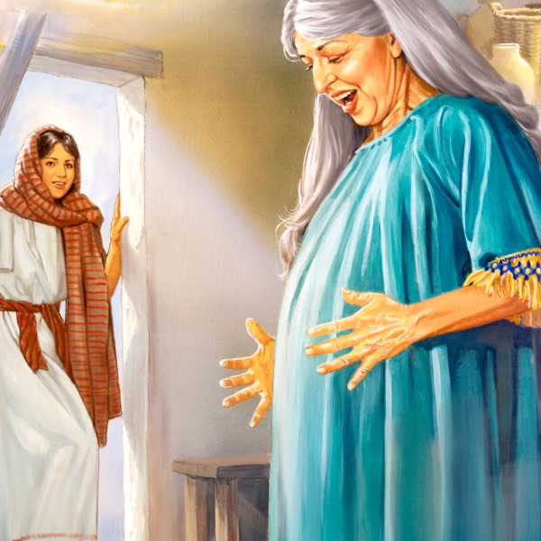
Question 1 – Part 2: What is the Unborn?
When does Human Life Begin?
2nd: The story of pregnant Mary visiting
pregnant Elizabeth.
Read: Luke 1: 24-44
Elizabeth and Zacharius (old and barren) lived in a village in “the hill country of Judah” (1:39), near to Jerusalem where Zacharius was serving as priest at the temple (1:8).
How old is John the Baptist? (36)
About 6 months in the womb.
How big is John?
Slightly bigger than your hand
Question
How old and how big is the unborn Jesus?
(Read carefully to see)
Notes:
The story of pregnant Mary visiting pregnant Elizabeth.
Let’s Read: Luke 1: 24-44
Where did this story take place?
Mary lived in Nazareth – in the north of Israel.
Elizabeth and Zacharius lived in a village somewhere in “the hill country of Judah” (1:39). This is imprecise, but likely close to Jerusalem, because Zacharius was serving as priest at the temple (1:8).
When the angel meets Mary, how old is John the Baptist? (36) 6 months.
How big is John? Slightly larger than your hand at this point.
How old is the unborn Jesus? [Don’t answer yet.]
How big is the unborn Jesus? [Don’t answer yet.] (Let’s read carefully to see if we can find the answer.)

Slide 19
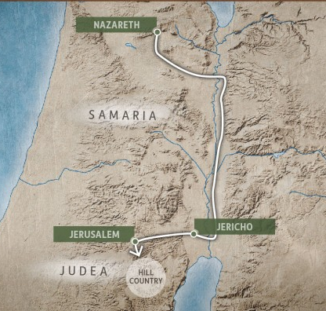
Question 1 – Part 2: What is the Unborn?
When does Human Life Begin?
2nd: The story of pregnant Mary visiting
pregnant Elizabeth.
(26-27) Mary was NOT pregnant when the
angel came to her in Nazareth.
(39) Mary went quickly.
Distance: Approx. 115-150 kms.
Time: Prob. 3-5 days (maybe a week)
(41) Mary was pregnant when she arrived.
Notes:
The story of pregnant Mary visiting pregnant Elizabeth.
Luke 1: 24-44
(26-27) Mary was not pregnant when the angel came to her in Nazareth.
(39) Mary went quickly.
Distance: Approx. 115-150 kms. Jews did not go through Samaria!
Time: Prob. 3-5 days (maybe a week)
(41) Mary was pregnant when she arrived and greeted Elizabeth.

Slide 20
Question 1 – Part 2: What is the Unborn?
When does Human Life Begin?
2nd: The story of pregnant Mary visiting
pregnant Elizabeth.
Q. How old and how big was the unborn Jesus when
Mary arrived?
A. From 1 day to a week old. [see also v. 56-57]
A. Small as a period. - [likely not yet implanted in the womb]
Never-the-less…
John leaps for joy announcing Jesus’ arrival – “The Lord has come!” - as he would 30 years later to Israel.
This is powerful affirmation of the humanity of unborn children.
  John’s very human response – leaping, joy
  Jesus’ arrival! He has come - the fully Divine God has now arrived as fully human! REJOICE!
Size, level of development, environment, degree of dependency – it doesn’t change this one fact…
…a human is human from the beginning!
Notes:
The story of pregnant Mary visiting pregnant Elizabeth.
Back to our questions…
How old was Jesus when Mary arrived and greeted Elizabeth? (Anywhere from 1 day old to a week old!) [See also verses 56-57. The angel told Mary (36) that Elizabeth was 6 months pregnant. Mary stayed 3 months and went home (56). Elizabeth gave birth (57) – at 9 months (full time). No mention of Mary now.]
How big was Jesus? No bigger than the period at the end of this sentence.
And probably not yet implanted in the womb - (that happens about Day 6 from fertilization).
Developmentally he was a zygote – just a few days old.
When Mary greeted Elizabeth, John leaped in Elizabeth’s womb!
It was like John was worshipping Jesus – who although very small was fully human! – Maybe we can call it a “womb to womb worship service!”
John, as an unborn child, leaped for joy and announced the coming of the Lord to his mother – “The Lord has Come!”
Just like he would do to all the people in Israel 30 years later.
John 1:29-34: “Behold! The lamb of God who takes away the sin of the world!”
Even though he was so small, yet Jesus, being both fully God and fully human, was also fully present.
This is powerful affirmation of the humanity of unborn children.
John’s very human response – leaping, joy
Jesus’ arrival! He has come! The fully Divine God has now arrived as fully human!
Size, level of development, environment, degree of dependency – it doesn’t change this one fact – a human is human from beginning! And that beginning is conception.
In the world view of the Bible, children are children, whether inside the womb or outside the womb!
When a mother announces “I’m having a baby,” she is reflecting God’s own view of it!

Slide 21
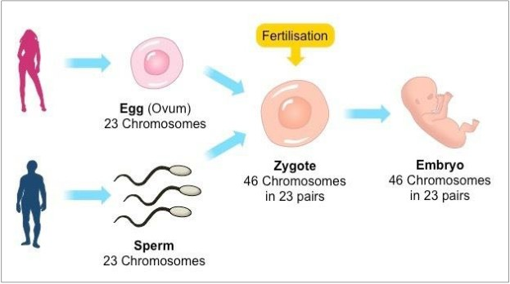
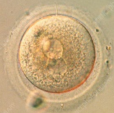
Question 1 – Part 2: What is the Unborn?
When does Human Life Begin?
3rd: Science Affirms what the Bible
Teaches
Fetal embryology teaches us that life begins at conception (fertilization).
At conception you are:
  A living human being
  A distinct human being
  A whole human being – that comes into existence and develops and matures from within through natural stages of maturation.
Life Begins Here
This fertilized ovum, known as a zygote, is the beginning of a new human being.

Slide 22
Question 1 – Part 2: What is the Unborn?
When does Human Life Begin?
3rd: Science Affirms what the Bible
Teaches
“A zygote is the beginning of a new human being. Human development begins at fertilization, the process during which a male gamete or sperm… unites with a female gamete or oocyte… to form a single cell called a zygote. This highly specialized, totipotent cell marks the beginning of each of us as a unique individual.”
  - Keith L. Moore & T. V. N. Persaud, The Developing Human: Clinically Oriented Embryology, page 16.
From this point on, nothing is added except nutrition!
The new human being is distinct from its father and mother – it is unique!
  The new baby has its own:
  blood type gender
  fingerprints footprints
  tongue print hair color
  eye color skin color
  body size DNA...
In latin, ‘fetus’ means “offspring.”
Notes:
We shouldn’t be surprised that science teaches the same as the bible.

Slide 23
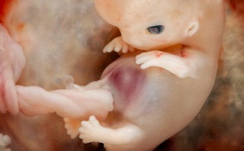
Question 1 – Part 2: What is the Unborn?
When does Human Life Begin?
3rd: Science Affirms what the Bible
Teaches
The official U.S Senate held a hearing on the question of when human life begins. This is their conclusion:
Physicians, biologists, and other scientists agree that conception marks the beginning of the life of a human being – a being that is alive and is a member of the human species. There is overwhelming agreement on this point in countless medical, biological, and scientific writings.
https://illinoisrighttolife.org/when-does-life-begin-lets-ask-the-experts/
Science Agrees That…
Every life begins at conception (fertilization)
Each preborn baby is a new and unique person
Preborn babies are our offspring
Each person has inherent worth because of who and what he or she is - a member of the human species!
A human baby at 7-8 weeks old

Slide 24
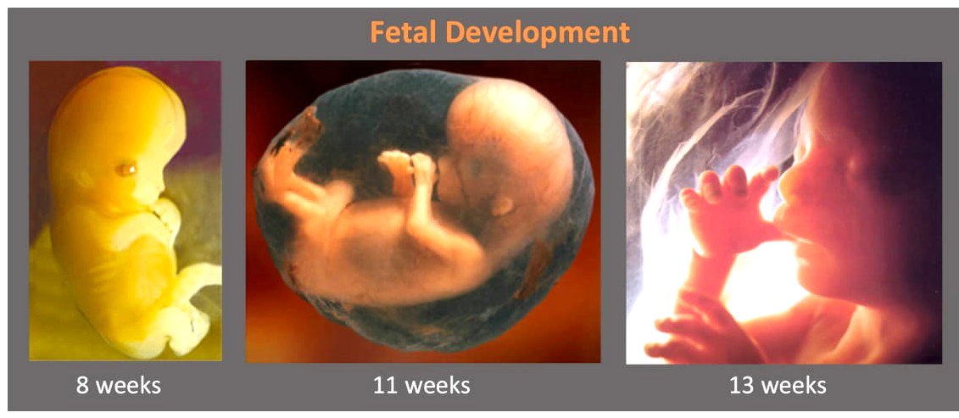
Question 1 - Part 2: What is the Unborn?
When does Human Life Begin?

Slide 25
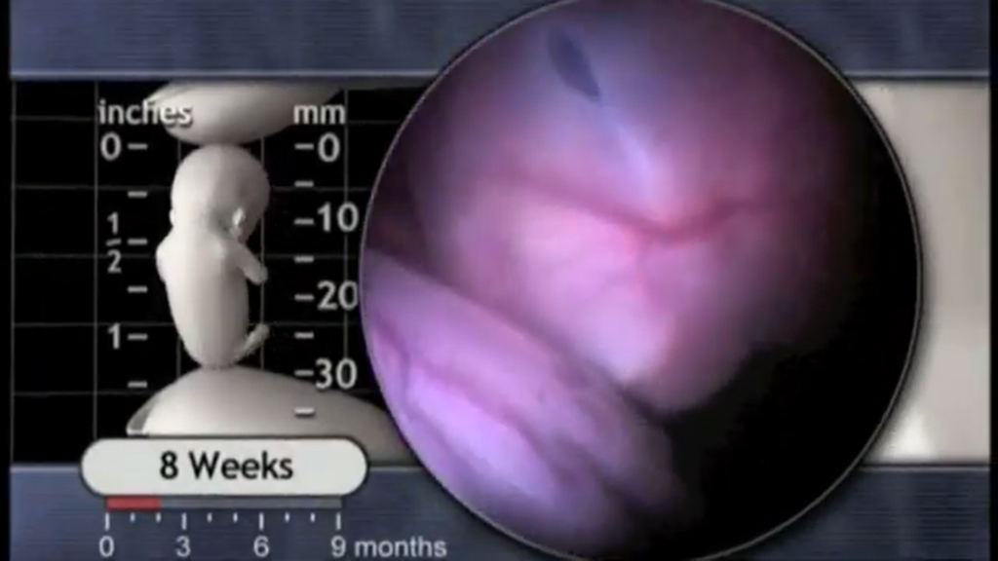
Question 1 - Part 2: What is the Unborn?
When does Human Life Begin?
4th: Life in the Womb is Reason to
Praise God.
Psalm 139:13-16 (NIV)
For you created my inmost being; you knit me together in my mother’s womb.
I praise you because I am fearfully and wonderfully made; your works are wonderful, I know that full well.
My frame was not hidden from you when I was made in the secret place, when I was woven together in the depths of the earth.
Your eyes saw my unformed body; all the days ordained for me were written in your book before one of them came to be.
Use of personal pronouns ‘I’ and ‘me’ show David sees himself as the same human at the time of writing as he was in the womb.
Our humanity in the womb is true – and amazing! As David reflects on being formed in the womb he gives praise to God.
Video (5 mins.)
            Watch the amazing journey of life in
            the womb - ‘Your Life Before Birth.’

Slide 26
Question 1: Part 1 What does God say about human life?
Part 2 What is the unborn? When does human life begin?
Discussion and Reflection
(Discuss with a friend)
What is the most important thing you learned so far?
What are the 4 values every person has?
Try retelling the story of pregnant Mary meeting pregnant Elizabeth.
Think about how you would answer these questions.
When does human life begin, and how do you know that?
Why do Christians believe every person, even unborn babies, have significant value?
What makes people more valuable than animals?

